Slide 1

Rosetta Stone Subscriber Optimization
Group 2: Jason Cabardo, Ben Fujii, Keivan Golchini, Sebastian Hong, Raina Rode, Nick Webster

Slide 2
Overview
Most Valuable Subscribers
Subscriber Segments
Subscribers with the Most Potential
Insights and Opportunities
Discontinuing Subscribers and Barriers
Failed Modeling Attempt
Business Opportunities
Key Points

Slide 3
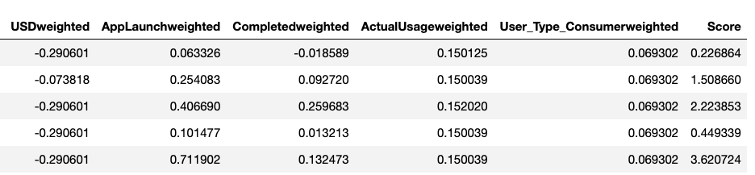
Most Valuable Subscribers
Goal
Identify top customers by engagement and spending
Identify characteristics of top customers
Plan
Standardize variables that reflect engagement and spending
Calculate a weighted score to avoid univariate analysis
Grade consumers from 1-10 based on weighted score percentile
Each variable weighted differently based on relevance/importance
Run linear regression model against the weighted score using customer characteristics as indicators

Slide 4
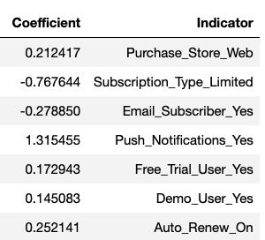
Most Valuable Subscriber Breakdown
Analysis
If the user receives push notifications, their grade goes up by 1.31 points or 13%
If the user has auto renewed on, their grade increases by 0.25 points or 2.5%
If the user purchased a lifetime subscription, their grade increases 0.77 points or 7.7%
Help improve number of highly graded customers

Slide 5
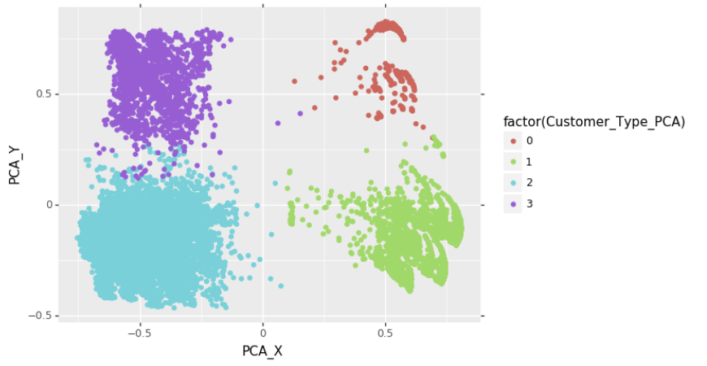
Subscriber Segments
Goal
Understand subscriber segments
Plan
Z-score variables to scalable comparison
Utilize KMeans to cluster 4 separate groups of the subscriber segments
Compare subscription types and respective purchase amounts

Slide 6
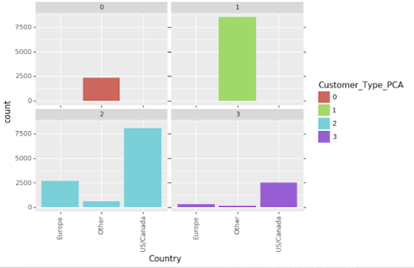
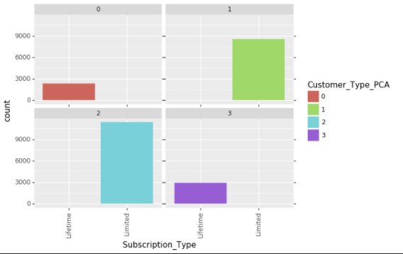
Understanding Each Segment
Segment 0: Europe/Other, Lifetime Subscribers, Not Very Involved
Segment 1: Europe/Other, Limited Subscribers, Not Very Involved
Segment 2: US/Canada, Limited Subscribers, Very Involved
Segment 3: US/Canada, Lifetime Subscribers, Very Involved

Slide 7
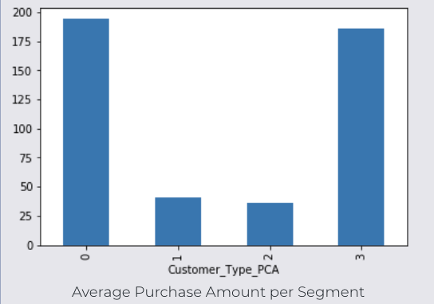
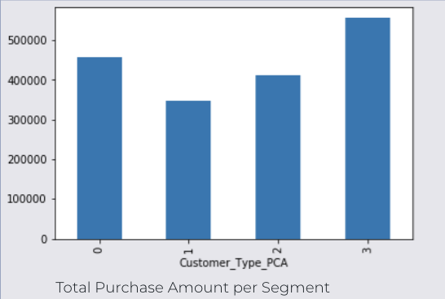
Segment Analysis
Greatest Number of Consumers
American/Canadian subscribers with limited subscription
American/Canadian subscribers with Lifetime subscriptions produce most revenue
Least Number of Consumers
European/Other subscribers with Lifetime subscription
Potential for Limited Subscription
Renewal, more clicks, opened more emails
Prominent Languages
Spanish, French, and English

Slide 8
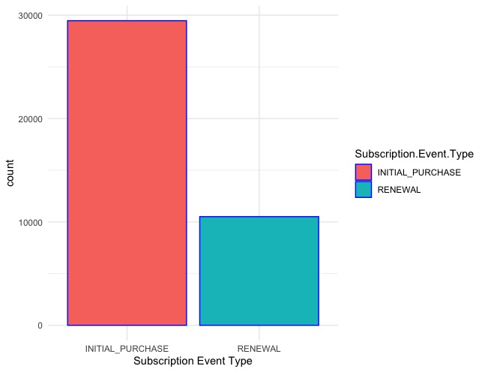
Subscribers with the Most Potential
Goals
Determine customer attributes that allows for renewal purchases
Limited subscriptions require renewal every 12 to 24 months
Auto Renew feature for subscribers who use products and services on a regular basis
Determine characteristics of long-term subscribers
View relationship between app activity and subscription period
Compare actual usage to subscription period
Plan
Create a logistic regression model predicting Subscription Event Type
Create a linear regression model predicting Subscription Period

Slide 9
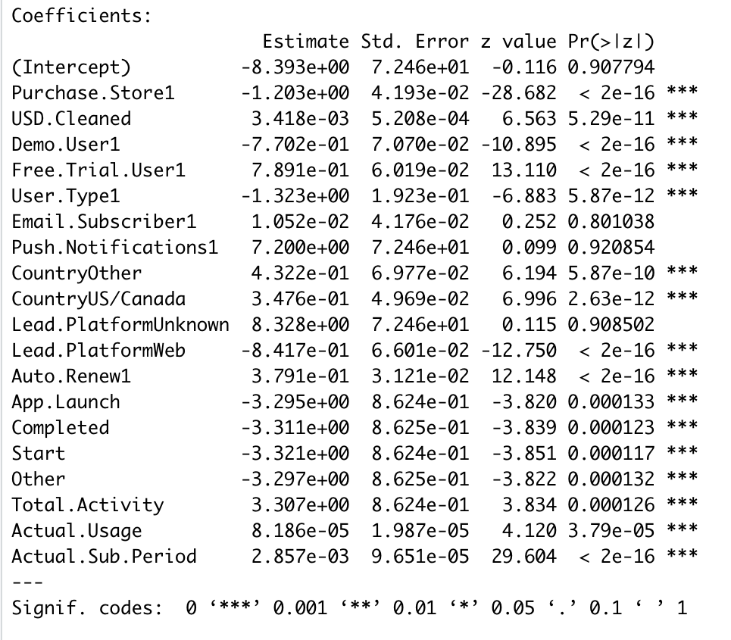
Subscription Event Type Prediction
Measures taken prior to modeling
Split data into 80/20 train-test split to ensure model validity
Only included "Limited" Subscriber Type
All binary variables converted to 0s and 1s
Predict whether a purchase is an initial purchase (0) or renewal (1)
Free Trial, Auto Renew On, and Subscription period have positive log odds
Purchase from the web, Demo User, and using the web as lead platform have negative log odds
AUC = 0.7607

Slide 10
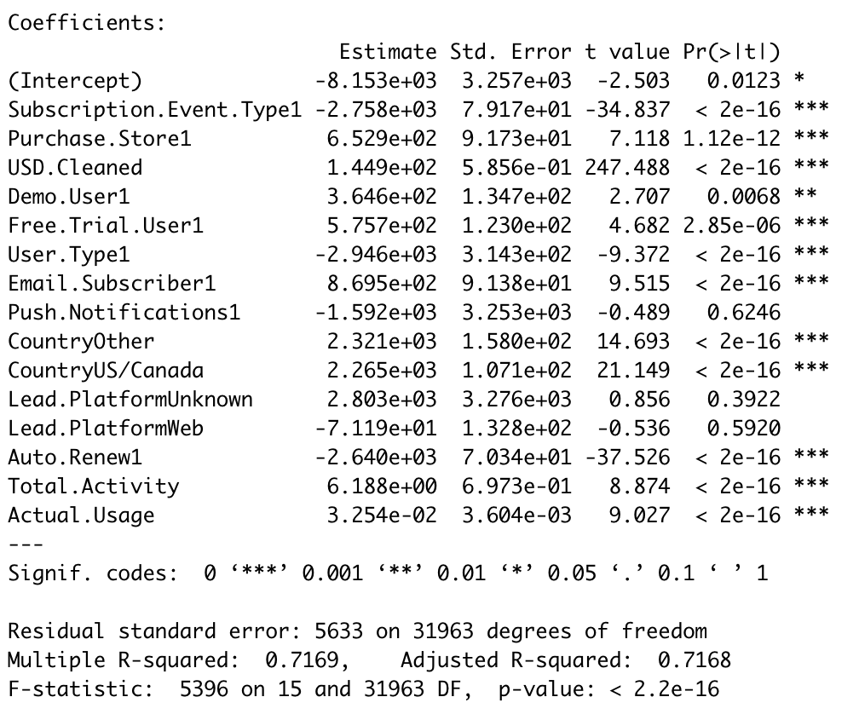
Subscription Period Prediction
80/20 Train-Test split
Predict the number of days within consumer subscription period
Positive Change on Subscription Period
Increase in purchase amount in USD by $1
Email Subscriber
Being from the US/Canada and Other non-European countries
Increase in total app activity by 1 action
Increase in Usage by 1 day
Negative Change on Subscription Period
Renewal Event Type
Non-consumer user
Auto Renew On
R^2 = 0.7169

Slide 11
Insights and Opportunities
Attributes that lead to more renewals and longer subscription period
Using a free trial
Turning on Auto Renew
Increase in purchase amount by $1
Subscribing to Rosetta Stone emails
Located in US, Canada, or other non-European countries
Increase in total app activity by 1 action
Increase in usage by 1 day
Potential Opportunities
Place advertisements for Rosetta Stone free trials throughout US, Canada, and non-European countries
Automatically have Limited subscriptions turn on Auto Renew and email subscription
Offer different tiers of subscriptions to increase initial purchase amount

Slide 12
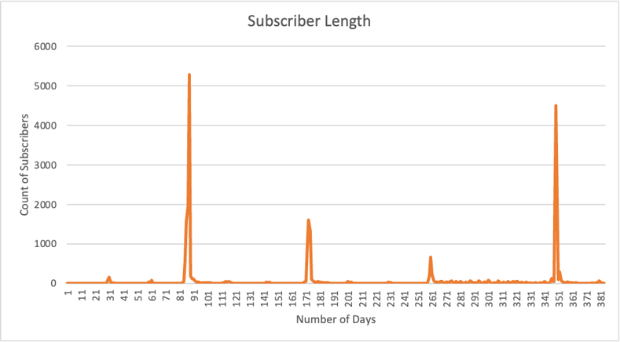
Discontinuing Subscribers
Goal
Identify subscriber profile for those who discontinue their subscriptions
Plan
Logistic Regression
Create variable "Discontinued" which accounts for subscription expiration and count of subscription length to predict if customer will discontinue with subscription
Use 10 predictor variables to predict "Discontinued" variable
Removed lifetime subscribers from data
Create binary variables, Z-score data, 80-20 train-test split
Take coefficients, exponentiate them to get log odds coefficients

Slide 13
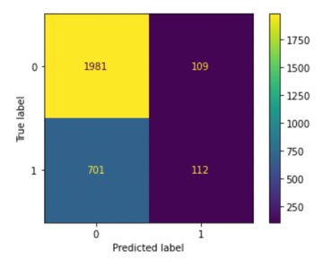
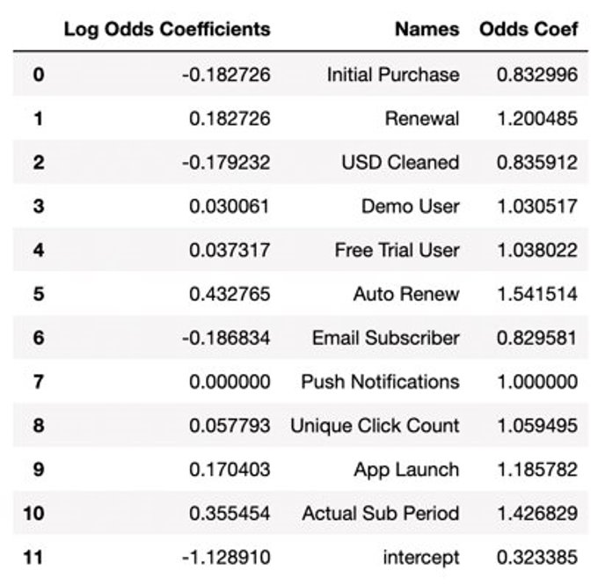
Discontinuing Subscribers
Insights
Use predicted values to generate accuracy score: 73.17
Auto renew and actual sub period had highest odds coefficients
If someone has the software for a while and completes the language, they'll likely discontinue
Subscriber profile: users have had the subscription for a while, have renewed the app/have auto-renew enabled, and use the app fairly frequently
Focus on retaining long-term customers and keeping them happy
Customer lifetime value
Quality customer service

Slide 14
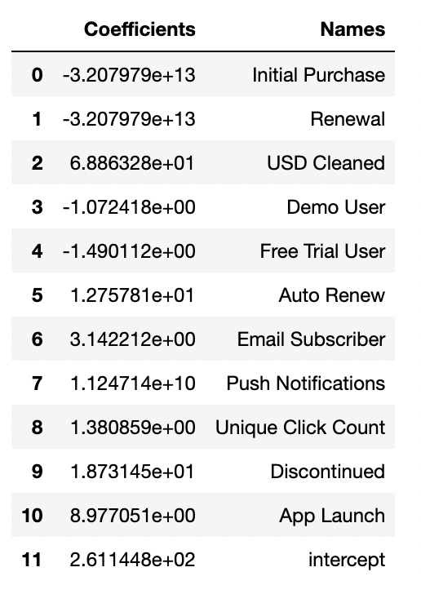
Barriers
Goal
Identify barriers to deeper subscriber engagement
Plan
Linear regression to predict subscription period
Used same data as logistic regression
Z-scored, 80-20 train-test split

Slide 15
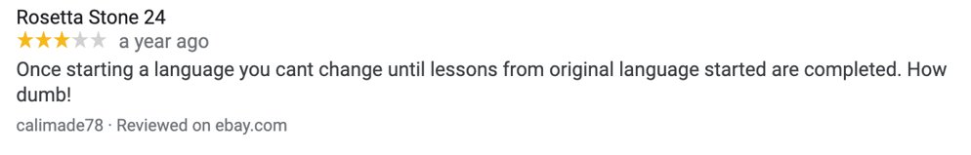
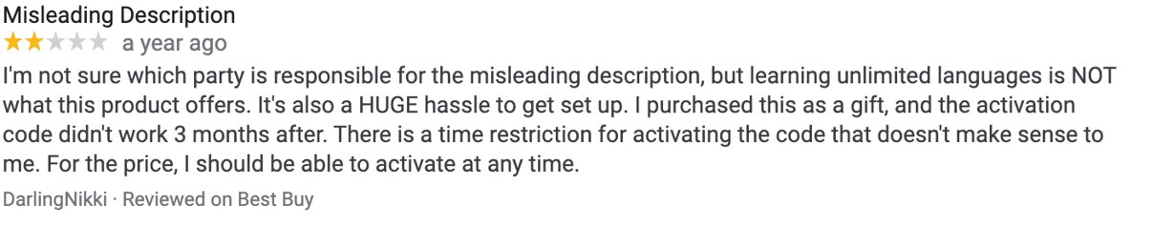
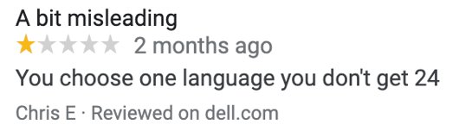
Barriers
Insights + Outside Research
R-squared was only around 0.24
Demo user and free trial user had the strongest negative impact on subscription length
Seems to be disconnect between demo/free trial and actual product subscription
Online reviews support this
Very important to not mislead consumers with demos and free trials
Whole point of free trial is to know what you're getting
Focus on transparency and clarity in product description

Slide 16
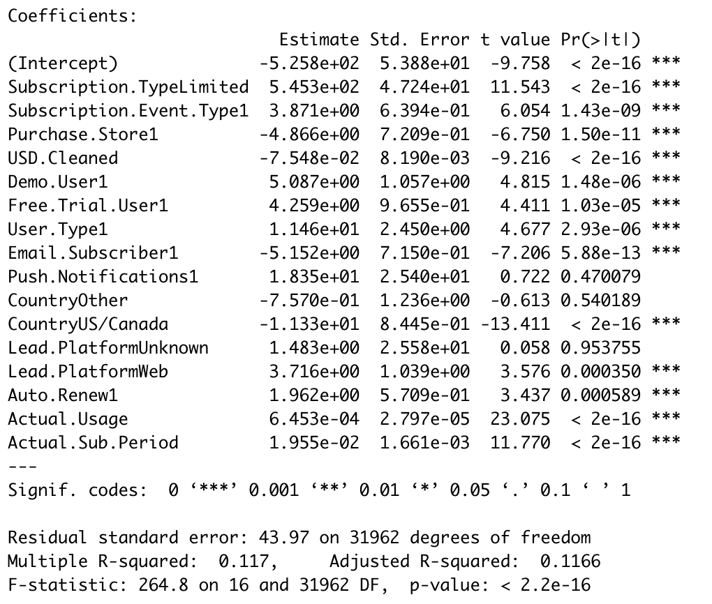
Failed Modeling Attempt
Poor linear regression model predicting Total App Activity
R^2 = 0.117
Not a lot of data fit to the model
Potential problems
Unknown Lead Platform with a P-value of 0.9538
Location in a country other than US, Canada, or Europe with a P-value of 0.5402
Turning on push notifications with a P-value of 0.4701
Majority of variables provide minimal change to app activity
Potential Solutions
Disregard variables with high P-values
Include other variables that may be in relation to total app activity
Email Count
Unique click count

Slide 17
Business Opportunities
Reasoning 1: Keep customers engaged with benefits
Promotions
Multi-language package discounts
Referral for a free course
Benefits for high-valued customers
Reasoning 2: Keep selling to returning customers
Promotions
Benefits to those on auto renew
Spend over a certain number
Use the mobile application

Slide 18
Key Points
Focus on push notifications, auto renew, and marketing Lifetime subscriptions to increase revenue
Focus on American/Canadian and Limited subscriptions to increase subscriber count
7 attributes lead to more renewals
Adding advertisements for free trials can boost sales
Ensure demo aligns with actual product
Marketing efforts can increase returning customers

